Slide 1
REHEAT RANKINE CYCLE
It was noted that increasing the boiler pressure increases the thermal efficiency of the Rankine cycle, but it also increases the moisture content of the steam to unacceptable levels.
Hence to have the advantage of increased thermal efficiencies at higher boiler pressures without facing the problem of excessive moisture at the final stages of the turbine, there are few methods.

Slide 2
REHEAT RANKINE CYCLE
Two possibilities can be,
Superheating the steam to very high temperatures before it enters the turbine. This would be desirable solution since the average temperature at which heat is added would also increase, thus increasing the cycle efficiency. But this is not a viable solution, since it requires raising the steam temperature to metallurgical unsafe levels.
Expanding the steam in the turbine in two stages and reheating the steam in between. That is, modifying the simple ideal Rankine cycle with a reheat process. Reheating is a practical solution to the excessive moisture problem in turbines and it is commonly used in modern steam power plants.
In a reheat Rankine cycle, the steam after partial expansion in the turbine is brought back to the boiler, reheated by combustion gases and then fed back to the turbine for further expansion. The flow and T-s diagrams for the ideal Rankine cycle with reheat are shown.

Slide 3
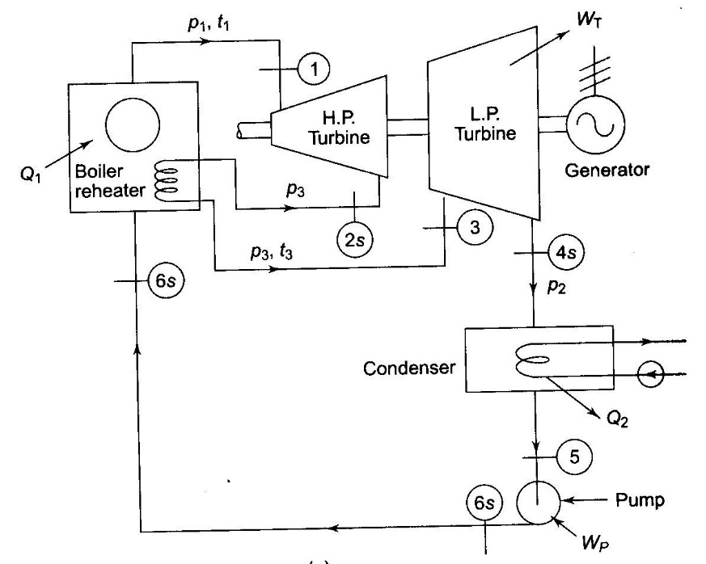
REHEAT RANKINE CYCLE
Flow diagram for the ideal Rankine cycle with reheat

Slide 4
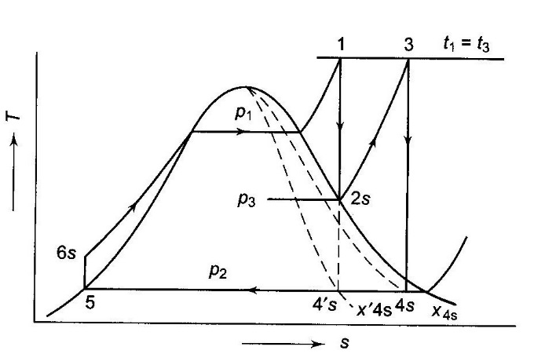
REHEAT RANKINE CYCLE
T-s diagram for the ideal Rankine cycle with reheat

Slide 5
REHEAT RANKINE CYCLE
In the reheat cycle, the expansion of steam from initial state 1 to the condenser pressure is carried out in two or more steps, depending upon the number of reheats used.
In the first step, steam expands in the high pressure (HP) turbine from the initial state to approximately the saturated vapour line (process 1 - 2s). The steam is then re-superheated or reheated at constant pressure in the boiler (process 2s - 3) and the remaining expansion (process 3 - 4s) is carried out in the low pressure (LP) turbine.
In the case of use of two reheats, steam is re-superheated twice at two different constant pressures.

Slide 6
REHEAT RANKINE CYCLE
To protect the reheat tubes, steam is not allowed to expand deep into the two-phase region before it is taken for reheating, because in that case the moisture particles in steam while evaporating would leave behind solid deposits in the form of scale which is difficult to remove.
Also, a low reheat pressure may bring down T_{m1} and hence cycle efficiency. But a high reheat pressure increases the moisture content at the turbine exhaust. Thus, the reheat pressure is optimized. The optimum reheat pressure for most of the modern power plants is about 0.2 to 0.25 of the initial steam pressure.

Slide 7
REHEAT RANKINE CYCLE
For 1 kg of steam,
Q₁ = (h₁ – h_{6s} ) + (h₃ – h_{2s})
Q₂ = h_{4s} – h₅
W_{T} = h₁ – h_{2s} + h₃ – h_{4s}
W_{P} = h_{6s} – h₅
η = (W_{T} – W_{P})/Q₁
= [(h₁ – h_{2s} + h₃ – h_{4s}) – (h_{6s} – h₅)]/(h₁ – h_{6s} + h₃ – h_{2s})
Steam rate = 3600/[(h₁ – h_{2s} + h₃ – h_{4s}) – (h_{6s} – h₅)] kg/kWh
Since higher pressures are used in a reheat cycle, pump work may be appreciable.

Slide 8
REHEAT RANKINE CYCLE
If the high pressure p₁ been used without reheat, the ideal Rankine cycle would have been 1 – 4’s – 5 – 6s, but with the use of reheat, the area 2s – 3 – 4s – 4’s has been added to the basic cycle.
The net work output of the plant increases with reheat, because (h₃ – h_{4s}) is greater than (h_{2s} – h_{4’s}) and hence the steam rate decreases.
Whether the cycle efficiency improves with reheat depends upon the whether the mean temperature of heat addition in process 2s – 3 is higher than the mean temperature of heat addition in process 6s – 1.

Slide 9
REHEAT RANKINE CYCLE
In practice, the use of reheat only gives a small increase in cycle efficiency, but it increases the net work output by making possible the use of higher pressures, keeping the quality of steam at turbine exhaust within a permissible limit. The quality improves from x’_{4s} to x_{4s} by the use of reheat.
By increasing the number of reheats, still higher steam pressures could be used, but the mechanical stresses increase at a higher proportion than the increase in pressure, because of the prevailing high temperature. The cost and fabrication difficulties will also increase. In that way, the maximum steam pressure gets fixed and more than two reheats are not generally used.

Slide 11
REHEAT RANKINE CYCLE
(2.) Steam enters the high-pressure turbine at 15 Mpa and 600°C and is condensed in the condenser at a pressure of 10 kPa. If the moisture content of the steam at the exit of the low-pressure turbine is not to exceed 10.4%, determine (a) the pressure at which the steam should be reheated (b) the thermal efficiency of the cycle. Assume the steam is reheated to the inlet temperature of the high pressure turbine.

Slide 12
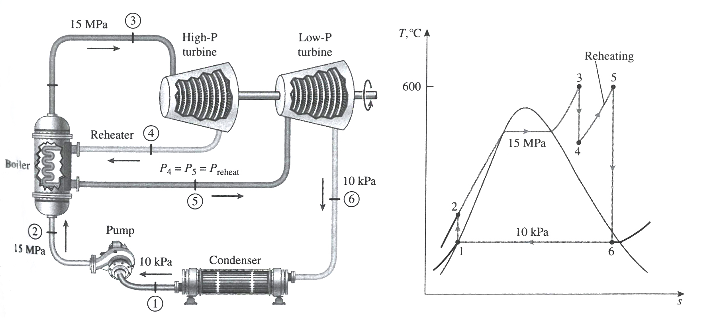
REHEAT RANKINE CYCLE
Sol (2.) Schematic diagram and T-s plot

Slide 13
REHEAT RANKINE CYCLE
Sol (2.)
Reheat pressure can be determined from the requirement that the entropies at states 5 and 6 be the same,
At state 6, p₆ = 10 kPa
x₆ = 0.896 (saturated mixture)
s₆ = s_{f} + x₆ s_{fg} = 0.6492 + 0.896 (7.4996) = 7.3688 kJ/kg K
Also, h₆ = h_{f} + x₆ h_{fg} = 191.81 + 0.896 (2392.1) = 2335.1 kJ/kg
Thus,
State 5, T₅ = 600°C, s₅ =s₆
p₅ = 4.0 Mpa, h₅ = 3674.9 kJ/kg
Therefore, steam should be heated at a pressure of 4 Mpa or lower to prevent moisture above 10.4%.

Slide 14
REHEAT RANKINE CYCLE
Sol (2.)
(b) To determine the thermal efficiency of the cycle, the enthalpies at all other states should be found
State 1, p₁ = 10 kPa (saturated liquid)
h₁ = h_{fp1} = 191.81kJ/kg, v₁ = v_{fp1} = 0.00101 m³/kg
State 2, p₂ = 15 Mpa, s₁ = s₂
W_{P} = v₁ (p₂ – p₁)
= 0.00101 m³/kg . [(15000 - 10)] kPa (1 kJ/1 kPa.m³)
= 15.14 kJ/kg
h₂ = h₁ + W_{P} = (191.81 + 15.14) kJ/kg = 206.95 kJ/kg
State 3, p₃ = 15 Mpa, T₃ = 600°C
h₃ = 3583.1 kJ/kg, s₃ = 6.6796 kJ/kg K

Slide 15
REHEAT RANKINE CYCLE
Sol (2.)
(b)
State 4, p₄ = 4 MPa, s₄ = s₃
h₄ = 3155.0kJ/kg, (T₄ = 375.5°C)
Thus, q_{in} = (h₃ – h₂) + (h₅ – h₄)
= (3583.1 – 206.95) + (3674.9 – 3155.0) = 3896.1kJ/kg
q_{out} = h₆ – h₁ = 2335.1 – 191.81 = 2143.3kJ/kg
η_{Thermal} = 1 – (q_{out}/q_{in})= 1 – (2143.3/3896.1) = 45%

